Slide 1



Developing a Profitable Algorithmic Trading System for Cryptocurrencies
Chris, Dino, Victor & Mike
Notes:
Developing a Profitable Algorithmic Trading System for Cryptocurrencies

Slide 2
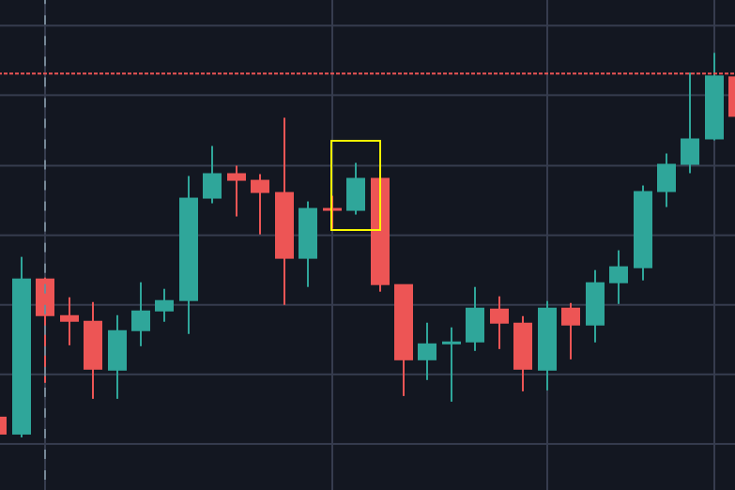
We venture to develop a profitable trading algorithm
designed to be applied to 5 of the highest market cap coins
in cryptocurrency.
This sector represents an exciting world of
volatility and leverage, which powerful strategies,
algorithms and cutting-edge technologies
are well suited for.
Mission Statement & Purpose
Notes:
We venture into the exciting and volatile world of cryptocurrency algorithmic trading. We are passionate about exploiting market anomalies and volatilities to make money, and we believe that algorithmic trading is the ideal tool for doing so. We have developed a trading system for the five highest market cap coins, leveraging powerful strategies, algorithms, and cutting-edge technologies to capitalize on short-term market movements.

Slide 3

Research Questions
Our research questions are as follows:
What specific trading strategy will the system employ?
Which specific cryptos should we target?
How can these strategies be optimized?
How profitable is this strategy utilized against one asset vs another?
How can we backtest our algorithms using paper trading?
Notes:
Researching a specific trading strategy on our system employed a fundamental question that helped guide the development of our entire system. We had to carefully consider the different types of trading strategies available and the specific characteristics of cryptocurrency markets.
With over 19,000 cryptocurrencies currently in existence, we needed to narrow down our focus to a select few.
Once we have selected a trading strategy and cryptocurrencies to target, we needed to optimize our system for maximum profitability.
How profitable would this trading strategy be utilized against one asset vs another?
To do so we will need conduct backtesting and paper trading to assess the profitability of our strategy across different cryptocurrencies.
Well, how can we backtest our algorithms using paper trading in the first place and what is it in the first place?
We learned that backtesting is the process of evaluating the performance of a trading strategy on historical data.
Paper trading is a type of backtesting that uses simulated funds to trade virtual assets.
We will use paper trading to test our algorithms on different market conditions and to optimize our parameters.

Slide 4

Cryptocurrencies:
Bitcoin
Ethereum
Solana
Cardano
Polygon

Slide 5
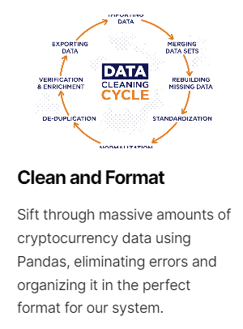
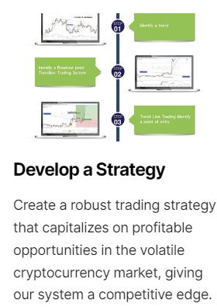

Overview of Tasks
Data cleaning and formatting
Strategy development
Visualization/Streamlit
Integration
Backtesting
Paper trading and optimization
System Design & Architecture: To be led by Christopher, outlining the main components of the trading system and how they will interact.
Algorithm Development: Chris and Dino will collaborate to design, test and optimize our trading algorithms using Backtrader.
Interface Design: Mike will take the helm in designing a sleek, intuitive, and interactive interface using Streamlit, ensuring the system is user-friendly and efficient.
Data Management: Data sourcing, formatting and data management to be led by Victor.
Integration & Testing: The team will collaborate in this final phase to integrate all system components, followed by rigorous testing to ensure optimal performance.

Slide 6
Streamlit Demo

Slide 7

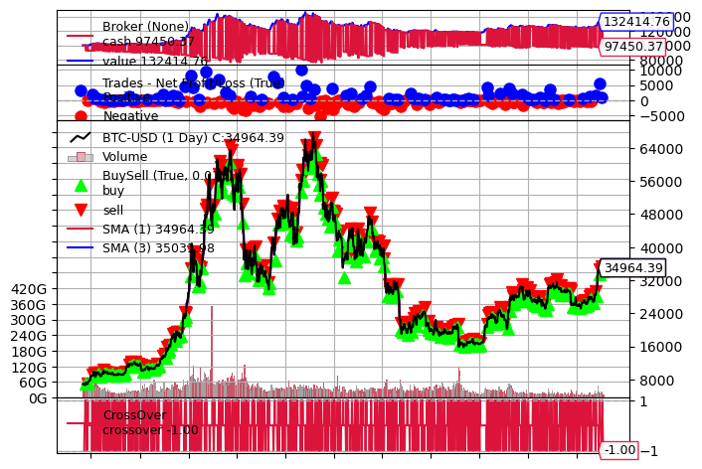
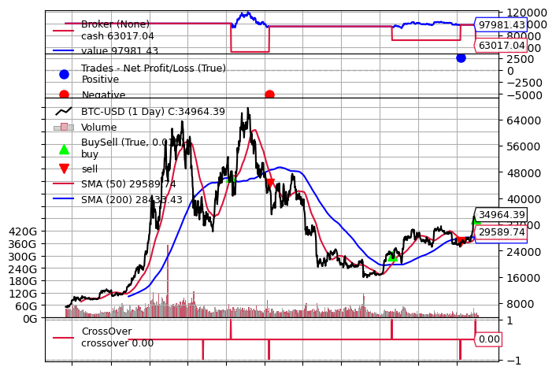
Swing Trading vs Simple Moving Average
Notes:
BTC
Final Portfolio Value using Swing Trading Strategy for BTC: $132414.76
The Swing Trading Strategy for BTC had a $32414.76 profit over its initial investment of $100000.
Final Portfolio Value using SMA Strategy for BTC: $97981.43
The SMA Strategy for BTC had a $-2018.57 loss over its initial investment of $100000.
The difference in value between the Swing Trading Strategy and the SMA Strategy for BTC is: $34433.33
with the Swing Trading Strategy being the most profitable strategy for BTC with $32414.76 profit over its initial investment of $100,000.

Slide 8

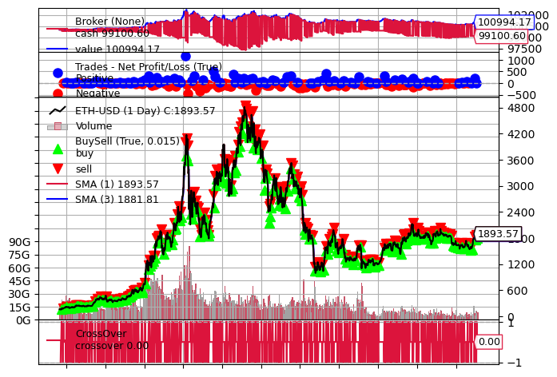
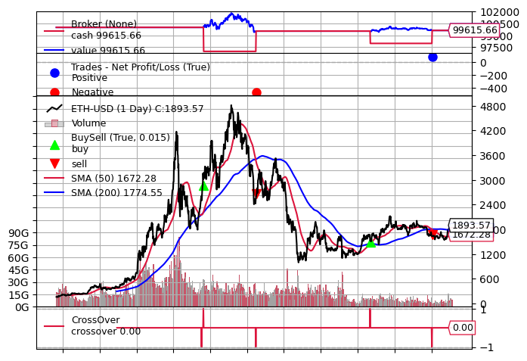
Swing Trading vs Simple Moving Average
Notes:
ETH
Final Portfolio Value using Swing Trading Strategy for ETH: $100994.17
The Swing Trading Strategy for ETH had a $994.17 profit over its initial investment of $100000.
Final Portfolio Value using SMA Strategy for ETH: $99615.66
The SMA Strategy for ETH had a $-384.34 loss over its initial investment of $100000.
The difference in value between the Swing Trading Strategy and the SMA Strategy for ETH is: $32799.10
with the Swing Trading Strategy being the most profitable strategy for ETH with $994.17 profit over its initial investment of $100,000.

Slide 9

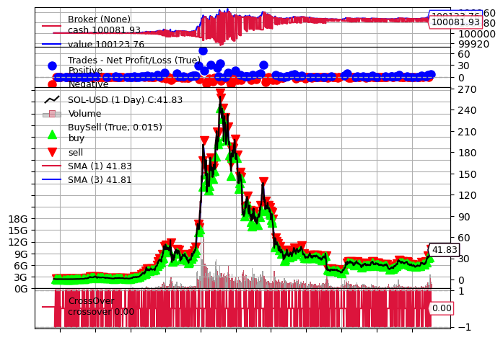
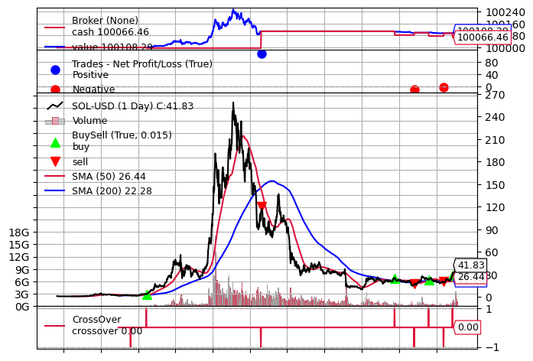
Swing Trading vs Simple Moving Average
Notes:
SOL
Final Portfolio Value using Swing Trading Strategy for SOL: $100123.76
The Swing Trading Strategy for SOL had a $123.76 profit over its initial investment of $100000.Final Portfolio Value using Swing Trading Strategy for SOL: $100108.29
The SMA Strategy for SOL had a $108.29 profit over its initial investment of $100000.
The difference in value between the Swing Trading Strategy and the SMA Strategy for SOL is: $15.47
with the Swing Trading Strategy being the more profitable strategy for SOL with $123.76 profit over its initial investment of $100,000.

Slide 10

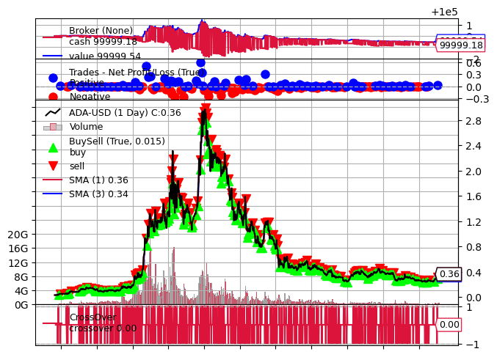
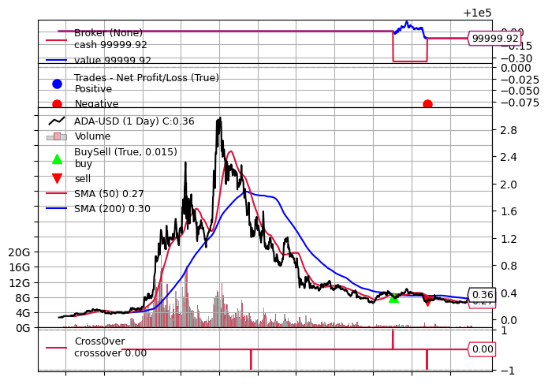
Swing Trading vs Simple Moving Average
Notes:
ADA
Final Portfolio Value using Swing Trading Strategy for ADA: $99999.54
The Swing Trading Strategy for ADA had a $-0.46 loss over its initial investment of $100000.
Final Portfolio Value using Swing Trading Strategy for ADA: $99999.92
The SMA Strategy for ADA had a $-0.08 loss over its initial investment of $100000.
The difference in value between the Swing Trading Strategy and the SMA Strategy for ADA is: $0.38
with the SMA Strategy being the better strategy for ADA with $-0.08 loss over its initial investment of $100,000
while the Swing Trading Strategy had a loss of $-0.46.

Slide 11

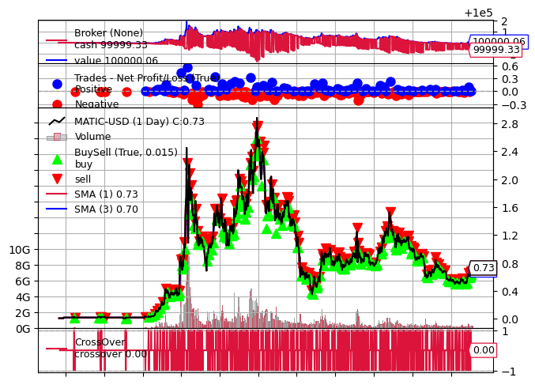
Swing Trading vs Simple Moving Average
Notes:
MATIC
Final Portfolio Value using Swing Trading Strategy for MATIC: $100000.06
The Swing Trading Strategy for MATIC had a $0.06 profit over its initial investment of $100000.
Final Portfolio Value using Swing Trading Strategy for MATIC: $100001.38
The SMA Strategy for MATIC had a $1.38 profit over its initial investment of $100000.
The difference in value between the Swing Trading Strategy and the SMA Strategy for MATIC is: $1.32
with the SMA Strategy being the most profitable strategy for MATIC with $1.38 profit over its initial investment of $100,000.

Slide 12
Strategy Conclusion & Results
While conducting a data analysis on the above outcomes, it appears that the Swing
Trading Strategy outperformed the SMA Strategy for most of the analyzed cryptocurrencies.
Initial Investment: $100,000.00 for each coin
Bitcoin: The Swing Trading Strategy for BTC had a $32414.76 profit
Ethereum: The Swing Trading Strategy for ETH had a $994.17 profit
Solana: The Swing Trading Strategy for SOL had a $123.76 profit
Cardano: The Swing Trading Strategy for Cardano had a $-0.46 loss
Polygon: The Swing Trading Strategy for MATIC had a $0.06 profit
Cryptocurrency | Swing Trading Strategy Final Portfolio Value | SMA Strategy Final Portfolio Value | Difference | Most Profitable Strategy
BTC | $132,414.76 | $97,981.43 | $34,433.33 | Swing Trading Strategy
ETH | $100,994.17 | $99,615.66 | $1,378.50 | Swing Trading Strategy
SOL | $100,123.76 | $100,108.29 | $15.47 | Swing Trading Strategy
ADA | $99,999.54 | $99,999.92 | $0.38 | SMA Strategy
MATIC | $100,000.06 | $100,001.38 | $1.32 | SMA Strategy

Slide 13
Links & Resources
Deployed application (Streamline): https://appgit-ntxdnpynzvvagvuvuquvtc.streamlit.app/
https://github.com/Chrisdeleon91/HFT-Project-1

